Slide 1
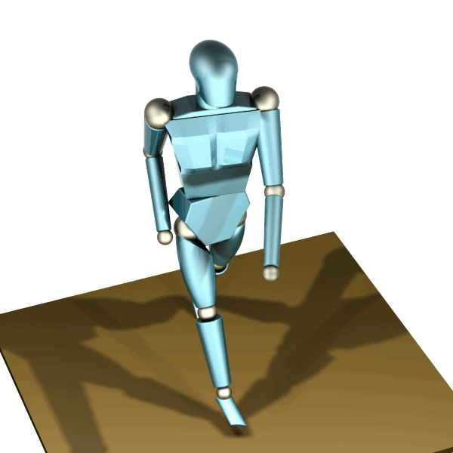
Robo-Daycare
Anmol Khanna
Anubhab Sen
Geethika Rasineni
Pooja Anjee Saurabh Ravindranath

Slide 2
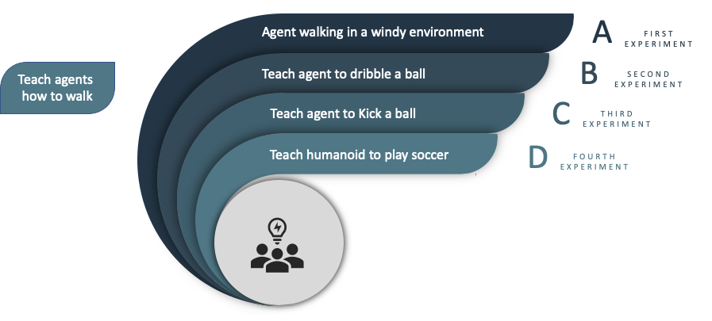





What We Built?
Transfer Learning

Slide 3
Results and Analysis
How effective is transfer learning?
To identify the feasibility of transfer learning in this domain
Use transfer learning to teach the agents how to walk in windy environments
Experiment one

Slide 4
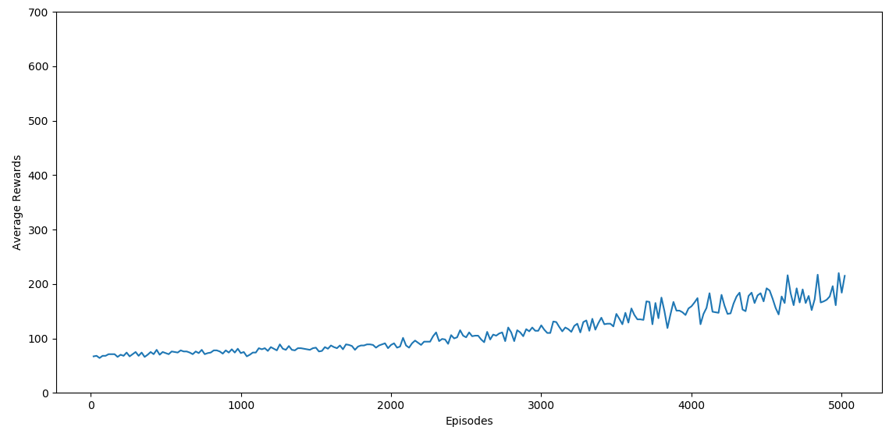
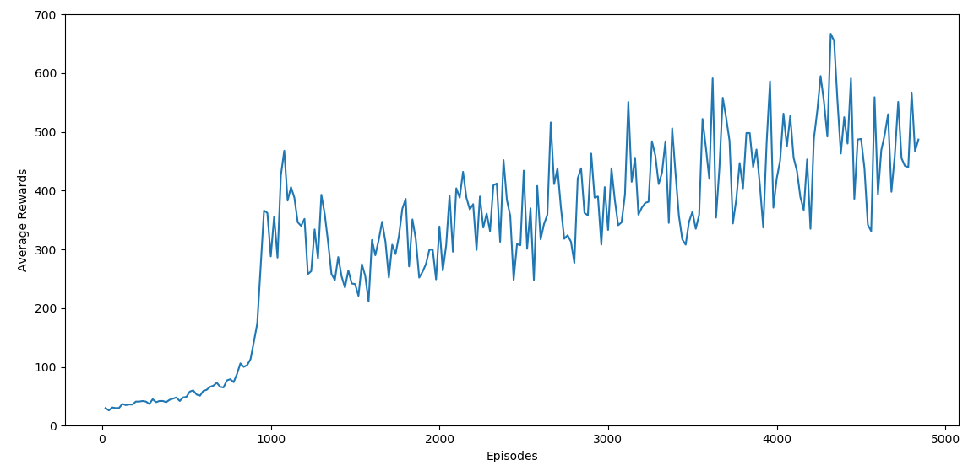
Results of Experiment one
Hopper-Wind environment- when the agent is trained from scratch.
Hopper-Wind environment -using transfer learning

Slide 5
Transfer learning proved to be computationally less expensive and much faster

Slide 6
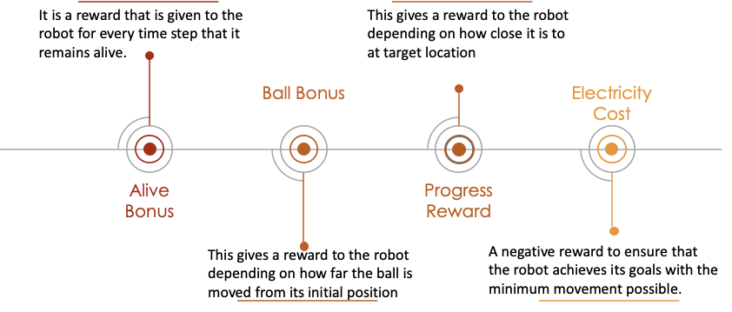
Reward Functions

Slide 7
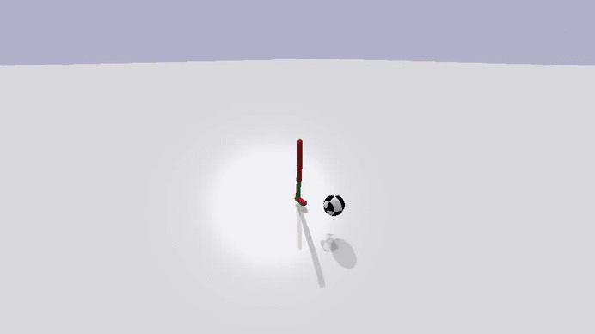
Teaching agent to play soccer
Walker dribbling a ball

Slide 8
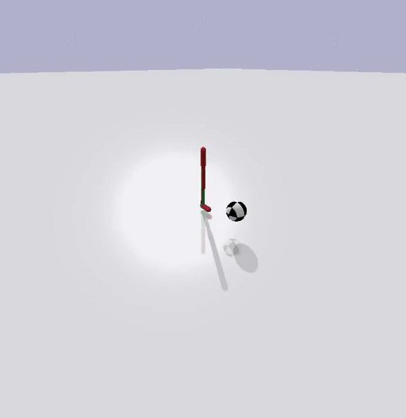
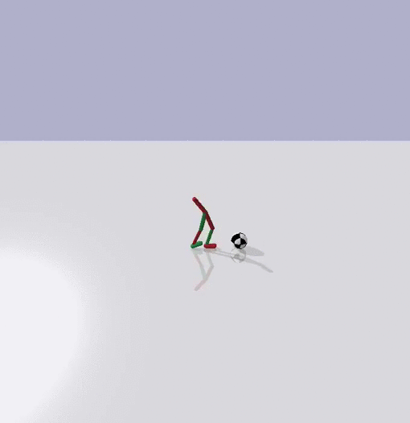
Agent Learning to Kick the Ball
When reward function is dominated by Alive Bonus
When reward function is dominated by Ball Bonus

Slide 9
Demo
Walker and Humanoid playing soccer

Slide 10
Applications
Optimize performance and time taken to train robots in tasks like Robo-soccer in the real world
Transfering learned behaviours in virtual environments to the real-world, resulting in reduced training time and cost
Can be used as base for animation in games and other animated media

Slide 11
Limitations
Conclusion
Transfer learning yields excellent results as long as Limitations are kept in mind
Future Work
Layering on objectives of increasing importance, mimicking human behaviour
Effectiveness depends upon careful selection of reward function and sequence of tasks

Slide 12
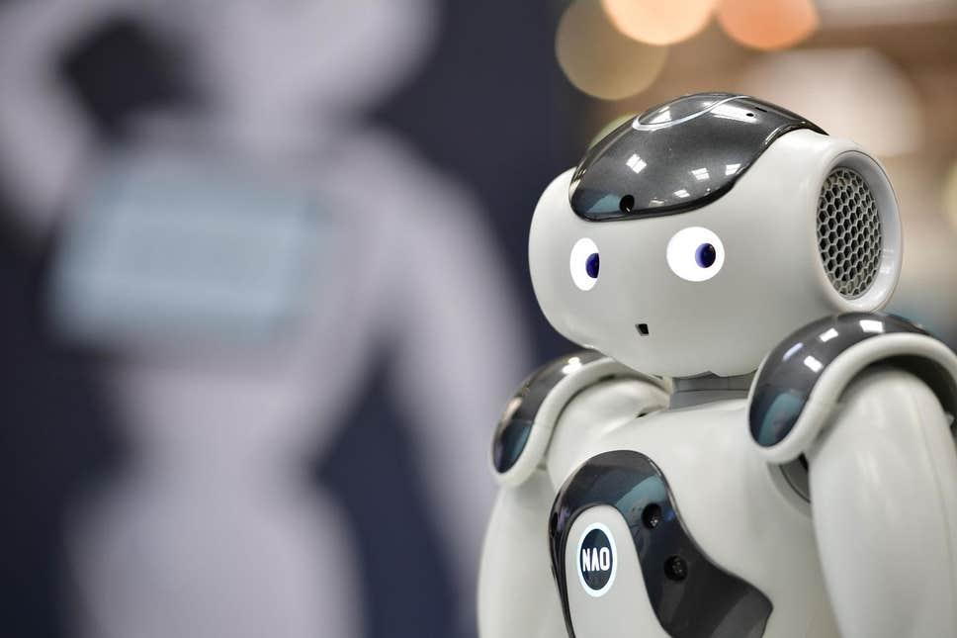
Thank you

